Slide 1




Web Programming
BIRYANI HEAVEN
Interactive Recipe Pages.........From TEAM-20

Slide 2




PROJECT SUMMARY
PROJECT TITLE: BIRYANI HEAVEN:DISHES AND SIDE NUMEROUS
PROJECT DESCRIPTION:A WEB-BASED PROJECT TO DEMONSTRATE INDIAN CUISINE'S BIRIYANI UTILIZING TRANSFORMATIONS, TRANSITIONS, AND ANIMATIONS
SUBHASH NIKHITHA
RAAVI TODETI
Cheif programmer and designer
Developer & Tester

Slide 3

TABLE OF CONTENTS
PROBLEM SOLUTION STATEMENT
KEY FEATURES
UML DIAGRAM
CODING
TESTING

Slide 4




PROBLEM STATEMENT
Biryani, a flavorful rice dish, has its roots in South Asia and typically consists of a blend of spices, vegetables, rice, and various meats such as chicken, beef, goat, lamb, prawn, or fish. Occasionally, it is prepared without meat and may include eggs and potatoes.
Interactive biryani recipe web pages should be created to ensure that this knowledge is accessible to food enthusiasts worldwide.

Slide 5

SOLUTIONS
Our team created the Biriyani Heaven website to acquaint you with the world of Biryani Cuisine and guide you in preparing authentic Biryani recipes independently.
The website aims to become the primary source for Biryani recipes, helping users create delicious dishes and explore the diverse culinary traditions of Indian culture.
This website is designed to serve both seasoned cooks and those new to cooking, providing easy access to search, learn, and prepare Biryani dishes.

Slide 6



FEATURES
The website offers a range of Indian
cooking recipes along with the ingredients needed to prepare them.
When a user clicks on a recipe, a new page will open with the ingredients shown first, followed by the recipe directions.
When an ingredient is hovered over by a user, the usage amount will be displayed as a flip card.
It also calculates the amount of time
needed to make your preferred Indian dish.
It also reveals
intriguing
information
about the recipes.

Slide 7


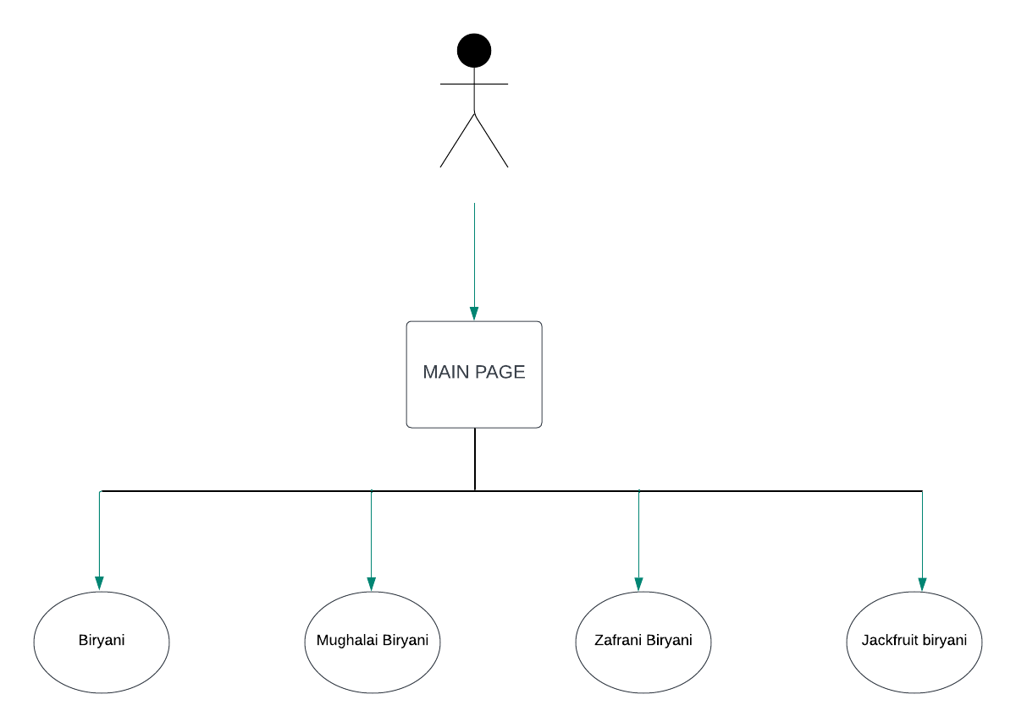


UML DIAGRAM

Slide 8
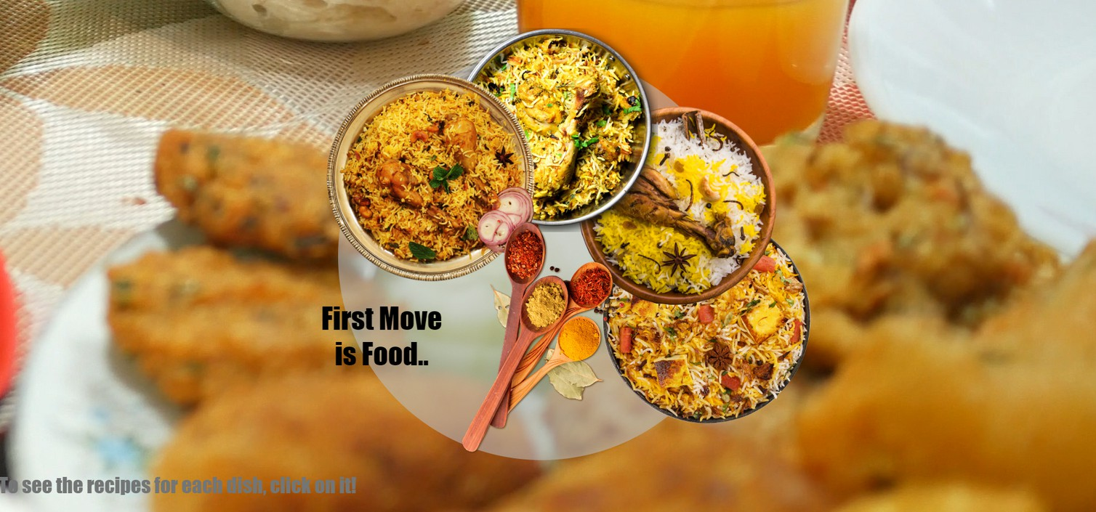
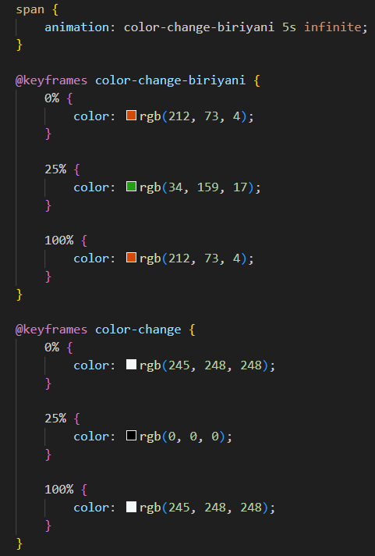
CODING
Main Page:

Slide 9
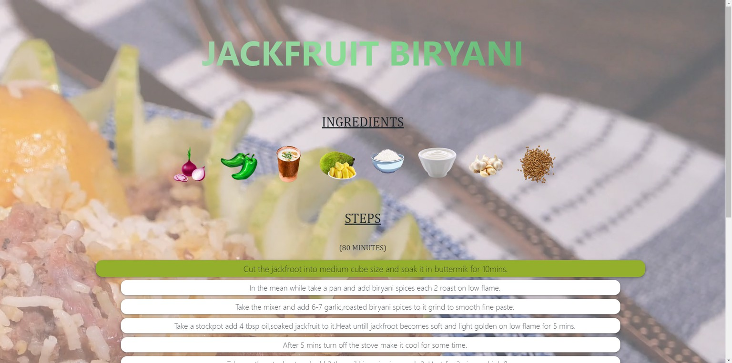
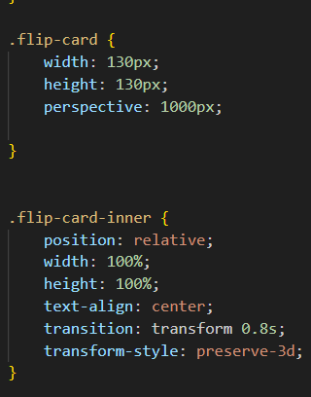
CODING
Recipe Page:

Slide 10
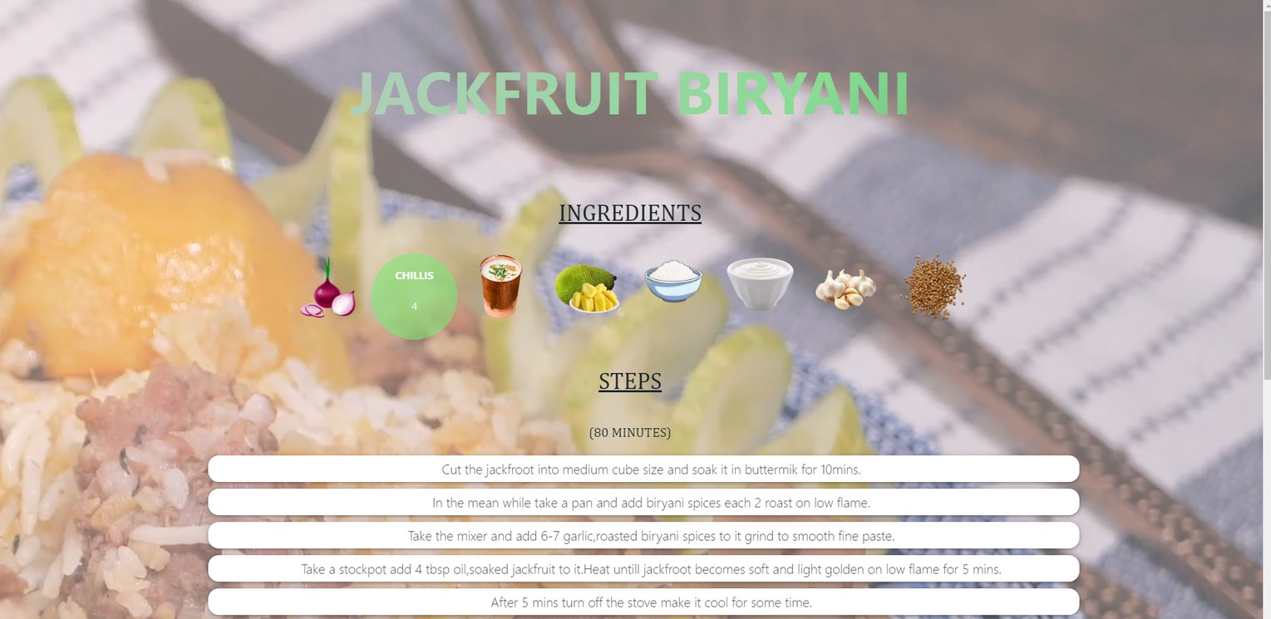
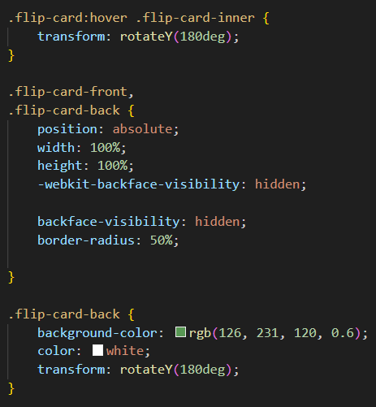
CODING
Transform, Transition & Animation :

Slide 11
TESTING
Usability Testing
CROSS-BROWSER AND CROSS DEVICE TESTING
Functional Testing
VALIDATION TESTING

Slide 12





REVIEW
Kanban Methodology
Visualize the work
Limit the Work in Progress
We kept the work items into an easy-to-read visuals using sticky notes
We bound to agile methodology the keeping track of work in progress
Focus and Flow
We managed the quality and quantity of work by focusing on other activities as well
Continous Improvement
We used plan–do–check–act. It is an iterative design and management method used in business for the control and continual improvement of processes and products

Slide 13





THANK YOU..........

